Slide 1
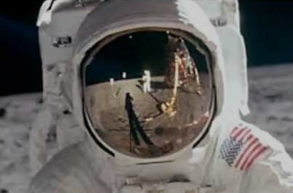
The Rocket Men
Project One Giant Leap

Slide 2
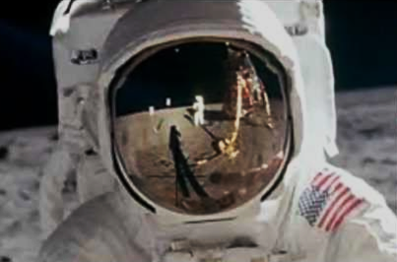
Dimensions
Rocket Length- 81.95 in.
Rocket Mass- 171 oz.
Top Body Tube Length- 27.7 in.
Bottom Body Tube Length- 36.0 in.
Cone Length- 16.75 in.
Body Tube Inner Diameter- 3.902 in.
Body Tube Outer Diameter- 4.094 in.
Static Stability Margin- 2.51 cal.

Slide 3
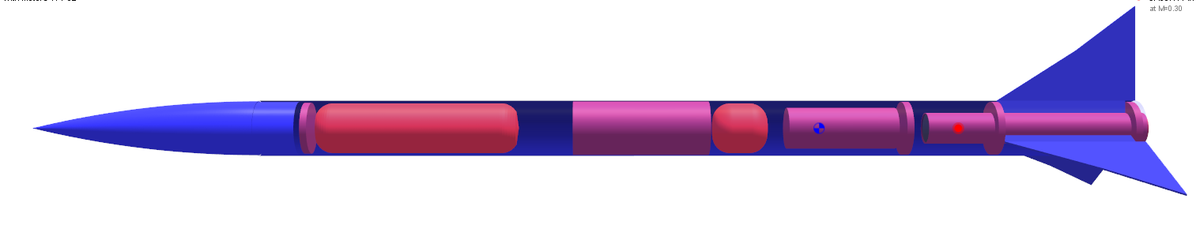
Materials for Rocket
Plastic Nose Cone
Fiberglass-wrapped Phenolic Body Tube
2.152” Motor Mount Tube
G10 FR4 Fiberglass for Fins
West Systems Epoxy
½ inch Plywood Centering Rings and Bulkheads
Spray Paint

Slide 4
Materials for Recovery System
  PerfectFlite StratoLogger Altimeter
Altimeter USB Data Transfer Kit
9 Volt Batteries for Altimeters
Electronics Arming Switch- Key Switches-
Type 3
3.9” Electronics Bay
Terminal Strips for Ejection Charges
15” Drogue Parachute
72” Iris Ultra Main Parachute

Slide 5
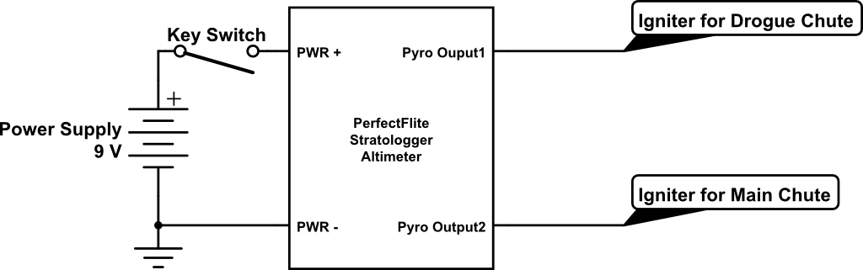
Materials for Recovery System Cont.
1”x25’ Tubular Nylon Shock Cord 4,200 lb. Test
30” of Kevlar Shock Cord Protector
½ inch Eyebolts
Quick Links

Slide 6
Materials for Payload Component
  Datalogger- USB Current and Voltage Datalogger
  3 Volt Lithium Battery for Datalogger
  ¼ inch Plywood for Bulkheads and Centering Ring
  Wooden Supports
  PT-3.0 Phenolic Tubing
  Diode and Resistor
  Memory Foam
  Clear Cast Acrylic- Lucite Cylinder
  Flexible Solar Panel
  Wires

Slide 7
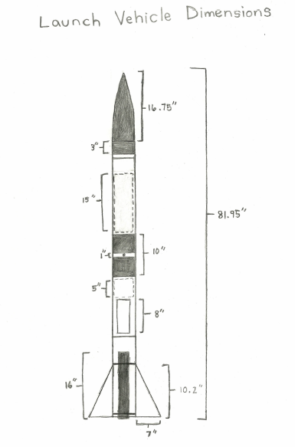
Plan for Vehicle Safety Verification and Testing
Bulkhead Testing
Ejection Charge Testing
Recovery System Harness Testing

Slide 8
Baseline Motor Selection and Justification
Cesaroni Technology Inc. K2045 Vmax motor
54mm in diameter
16.0 in. in length
1417 Newton-seconds of impulse
Justification
  Commercial Availability
  Design Compatibility
  Affordability
  Rail Exit Velocity

Slide 9
Thrust-to-Weight Ratio and Rail Exit Velocity
Thrust-to-Weight Ratio (T/W)- 43.0
Rail Exit Velocity- 148ft/s

Slide 10
Launch Vehicle Verification and Test Plan Overview
Recoverability and reusability of the Rocket
Launch Configuration Sustainability
Recovery System Functionality

Slide 11
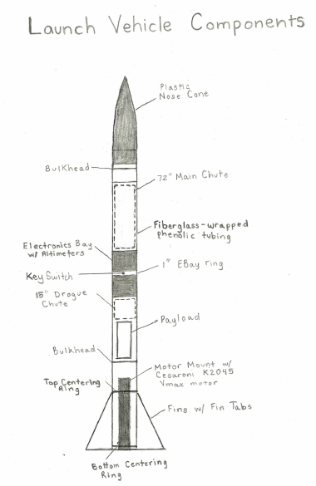
Drawing/Discussion of Each Major Component and Subsystem
Airframe
Recovery
Payload

Slide 12
Airframe
Nose Cone
Top Body Tube
Bottom Body Tube
Electronics Bay
  acts as a coupler
Bulkheads
Fins

Slide 13
Recovery
Dual Deployment
  Drogue Parachute
  Main Parachute
Electronics Bay
  Redundant Altimeters

Slide 14
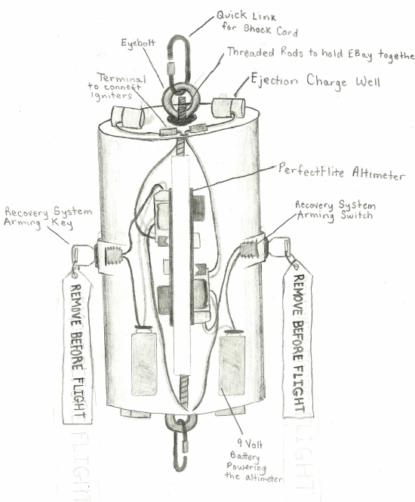
Recovery
Cont.
Altimeters
Ejection Charges
Arming Switches

Slide 15
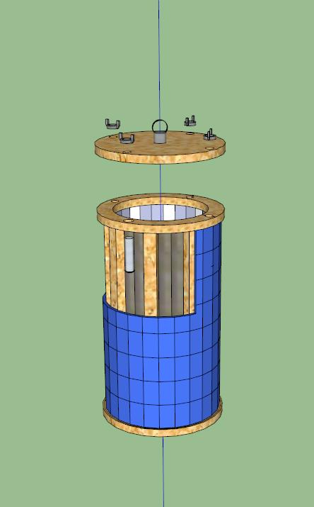
Payload
Payload Objective
Payload Description
    Structure
    Electronics

Slide 16
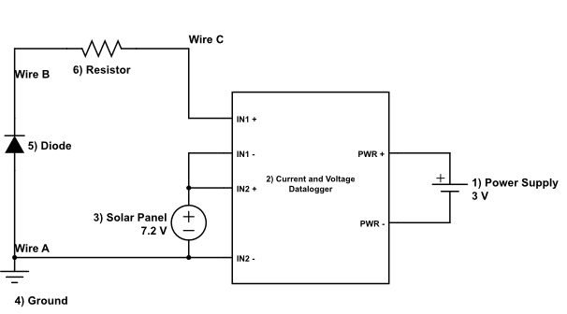
Baseline Payload Design

Slide 17
Baseline Payload Design Cont.
Flexible Solar Panel
Lucite Cylinder
Electronics
Datalogger

Slide 18
Payload Verification and Test Plan Overview
Collection and Analysis of the Payload Data
Recoverability and Reusability of the Payload

