Slide 1
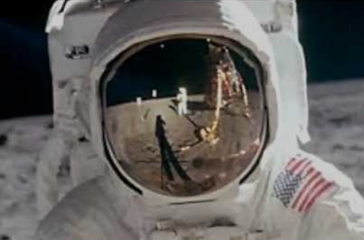
The Rocket Men
Project One Giant Leap

Slide 2
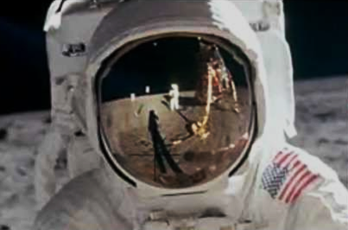
Design and Dimensions
Rocket Length- 81.95 in.
Rocket Mass- 16.7 lbs.
Top Body Tube Length- 27.7 in.
Bottom Body Tube Length- 36.0 in.
Cone Length- 18.25 in.
Body Tube Inner Diameter- 3.9 in.
Body Tube Circumference- 13.0 in.
Static Stability Margin- 2.51 cal.

Slide 3
Key Design Features of Launch Vehicle
Fin Configuration
Electronics Bay
Payload

Slide 4
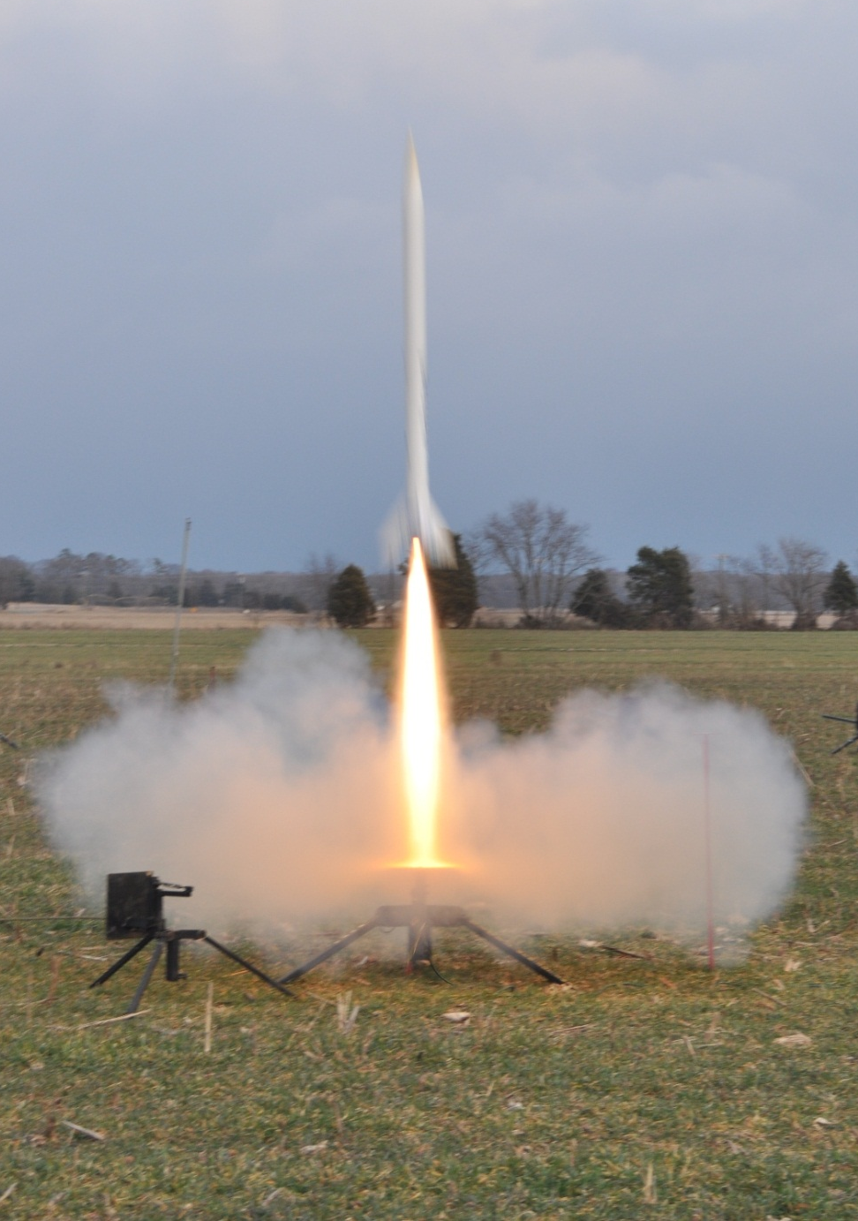
Motor Description
Cesaroni K2045 Vmax motor
  54mm diameter
  16.0 in. length
  1417 Newton-seconds of impulse
  Reliable rocket motor supplier
  Cesaroni motors are affordable given our budget.

Slide 5
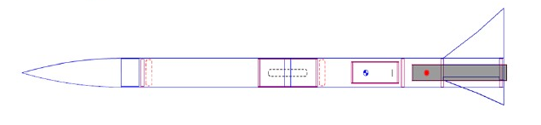
Rocket Flight Stability
Stability margin-2.56 cal.
CG: 58.1 inches
CP: 68.4 inches
Straight and consistent flights

Slide 6
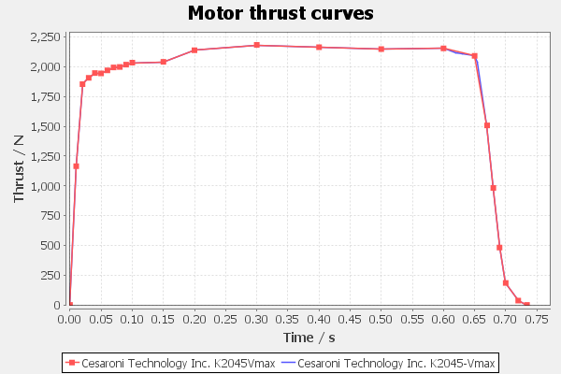
Thrust-to-Weight Ratio and Rail Exit Velocity
Rail Exit Velocity - 148ft/s
Thrust-to-Weight Ratio – 43.0

Slide 7
Mass Statement
Simulated mass of rocket
  10.7 lbs.
Mass of 1st rocket
  Total 16.7 lbs.
  Simulated Payload – 1.6 lbs.
  64% increase in mass

Slide 8
Parachute Sizes and Descent Rates
Drogue parachute
  15 inches
Main parachute 72 inches
Safe descent rate

Slide 9
Kinetic Energy at Key Phases
Key Phases:
  Drogue Parachute Deployment
    Top Half of Rocket: 486 ft-lbs
    Payload: 100 ft-lbs
    Back Half of Rocket: 607 ft-lbs
  Main Parachute Deployment
    Top Half of Rocket: 15.8 ft-lbs
    Electronics Bay: 5.5 ft-lbs
    Payload: 6.2 ft-lbs
    Back Half of Rocket: 25.8 ft-lbs

Slide 10
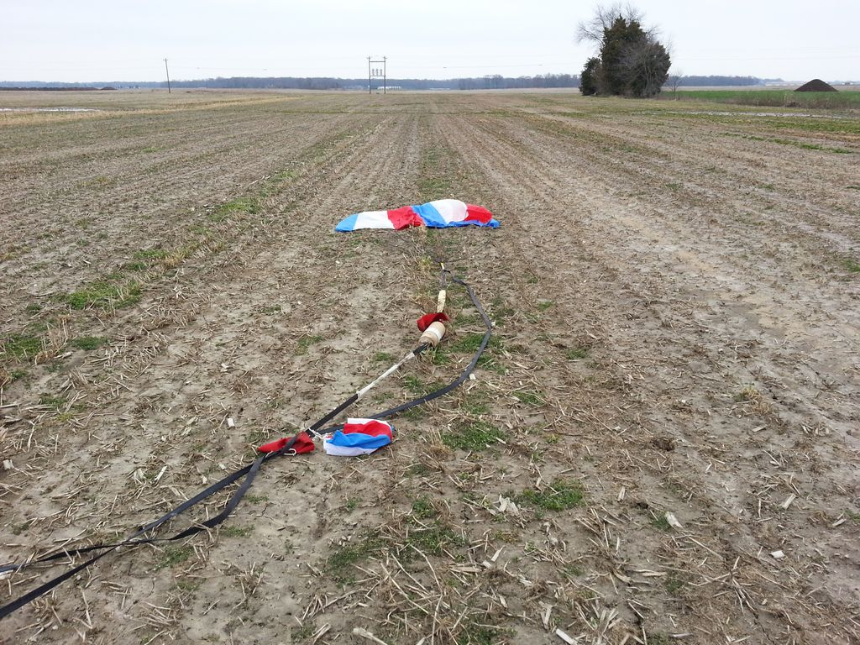
Predicted Altitude and Drift
Altitudes and Drift at each Wind Speed:
  5 mph
  10 mph
  15 mph
  20 mph

Slide 11
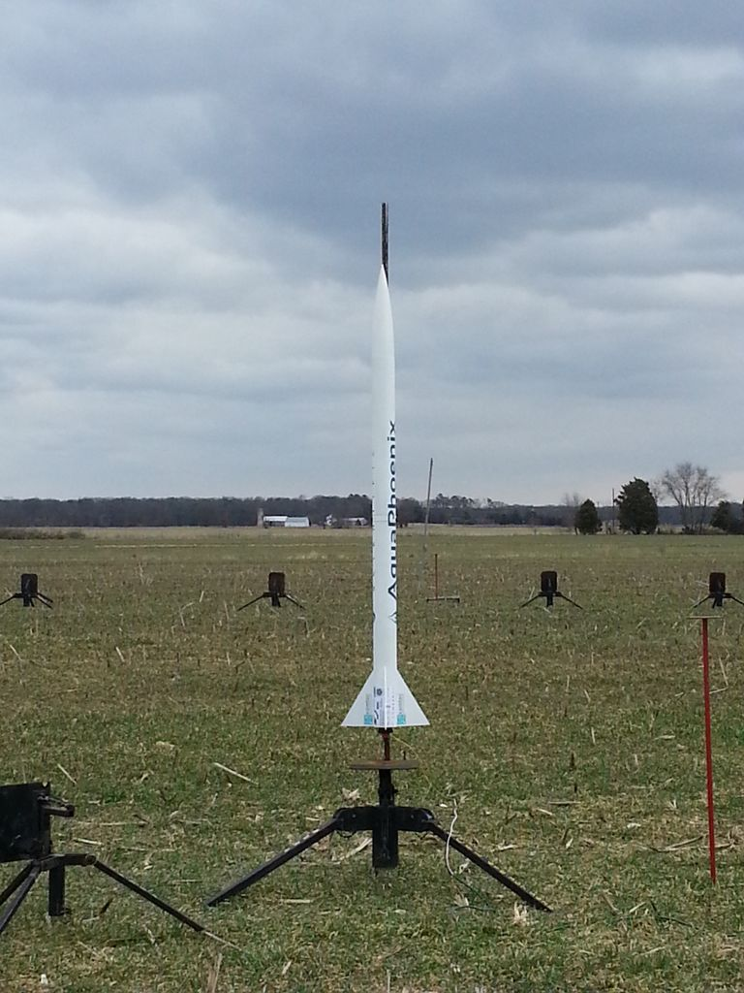
Test Plans and Procedures
Another Full-Scale Launch
Launch Procedures
  Safety precautions

Slide 12
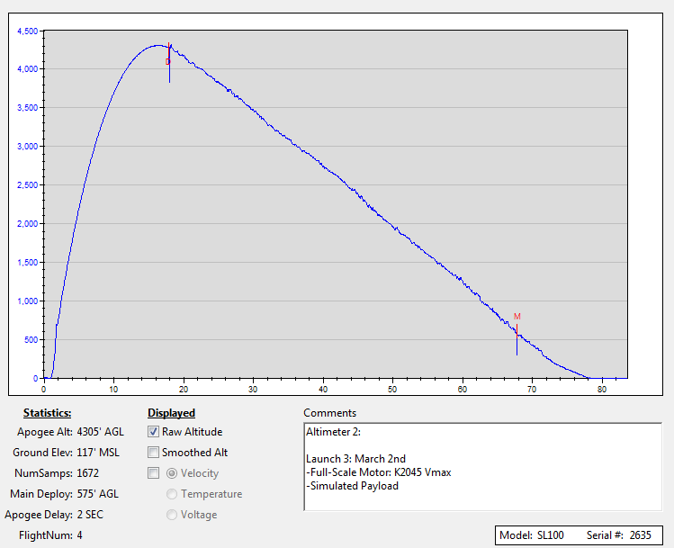
Full-Scale Flight Test Data

Slide 13
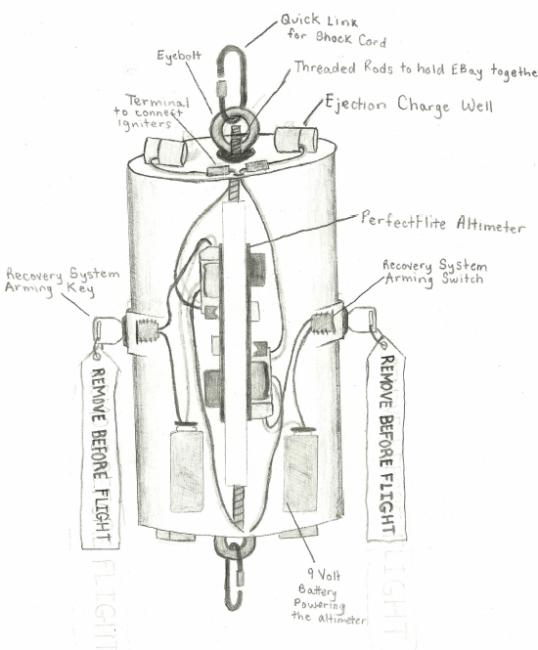
Recovery System Tests
Electronics Bay
  Altimeters
  Black-powder
Full-Scale Launch

Slide 14
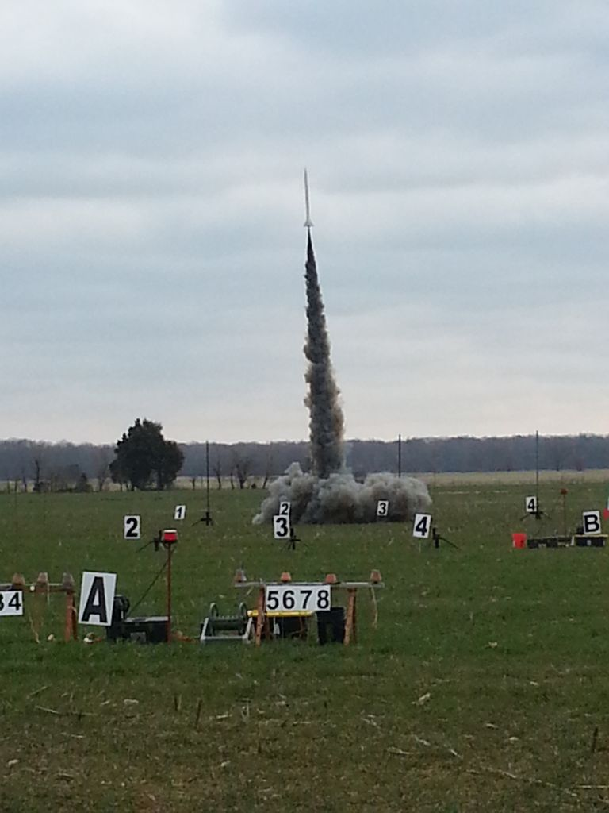
Launch Vehicle Requirement Verifications
Airframe
  Fin Configuration
Recovery System
  Drogue Parachute
  Main Parachute
  Electronics Bay

Slide 15
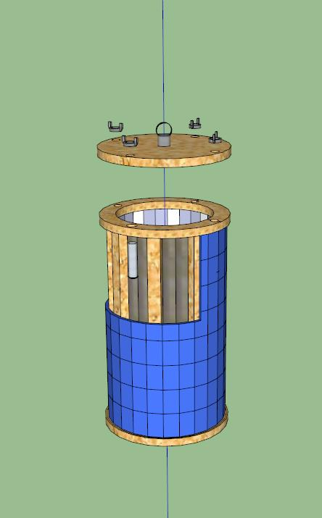
Payload Design and Dimensions
Flexible solar panel
  Wooden trusses
Electronics
Payload Airframe

Slide 16
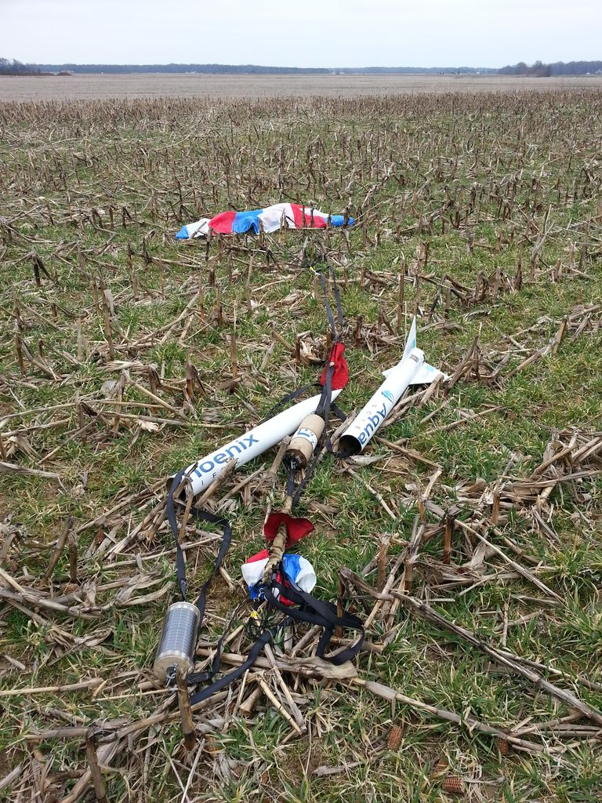
Payload Key Design Features
Flexible Solar Panel
Protective Lucite Cylinder
Programmable Arduino
Interchangeable Parts

Slide 17
Payload Verification Requirements
  Changes to Payload need approval by NASA
  Use of Scientific method
  Recoverability and Reusability of Payload

Slide 18
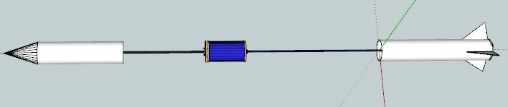
Payload Integration
Bottom half of rocket
In line with shock cord
Drogue parachute attached to the shock cord above payload-not attached to the payload

Slide 19
Interfaces with Ground Systems
Rocket Airframe
Electronics Bay
Payload
Parachutes

