Slide 1
The Rocket Men
Project One Giant Leap

Slide 2
Final Launch Vehicle Dimensions
Rocket Length- 81.95 in.
Rocket Mass- 171 oz.
Top Body Tube Length- 27.7 in.
Bottom Body Tube Length- 36.0 in.
Cone Length- 18.25 in.
Body Tube Inner Diameter- 3.9 in.
Body Tube Circumference- 13.0 in.
Static Stability Margin- 2.51 cal.
All parts of the body tube will be coated in fiberglass. The body tube will be able to withstand high velocities. Our body tubing will be ordered with slots to accompany our fins; this will leave less room for error and will save time during construction.

Slide 3
Key Design Features
Electronics Bay Recovery System
Motor Retention System
Fin Attachment Method
Payload

Slide 4
Final Motor Choice
Cesaroni K2045 V-max Motor
Necessary motor retainer

Slide 5
Rocket Flight Stability in Static Margin Diagram
Center of Pressure is 68.4 inches from nose cone
Center of Gravity is 58.1 inches from nose cone
Margin is 2.56 with the motor

Slide 6
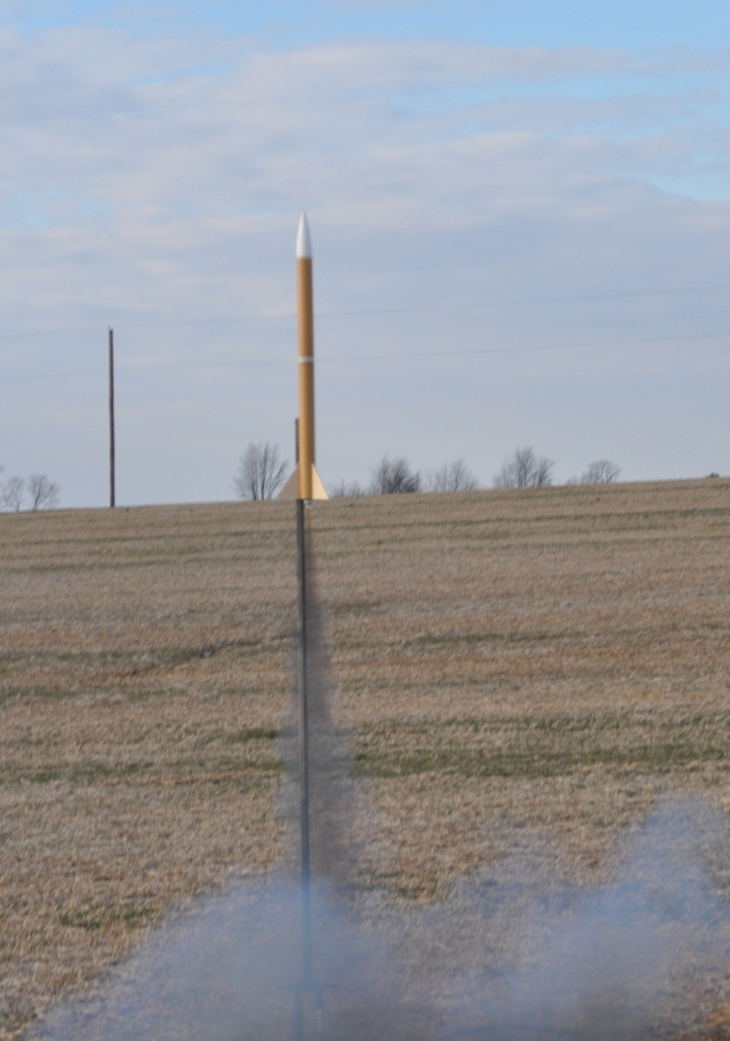
Thrust-to-Weight Ratio and Exit Rail Velocity
Thrust-to-Weight ratio is 42.55
Exit rail velocity is 147 feet per second

Slide 7
Mass Statement and Mass Margin
Total mass
Static stability margin is 2.56

Slide 8
Recovery System Specifics
Drogue Parachute
Recovery harness is 1 inch thick, and 20 feet long
Parachute size is 15 inches
Descent rates is 92.1 feet per second
Main Parachute
Recovery harness is 1 inch thick, and 25 feet long
Parachute size is 72 inches
Descent rates is 19.1 feet per second

Slide 9
Kinetic Energy and Key Phases of Mission
Calculated kinetic energy
Phases of mission

Slide 10
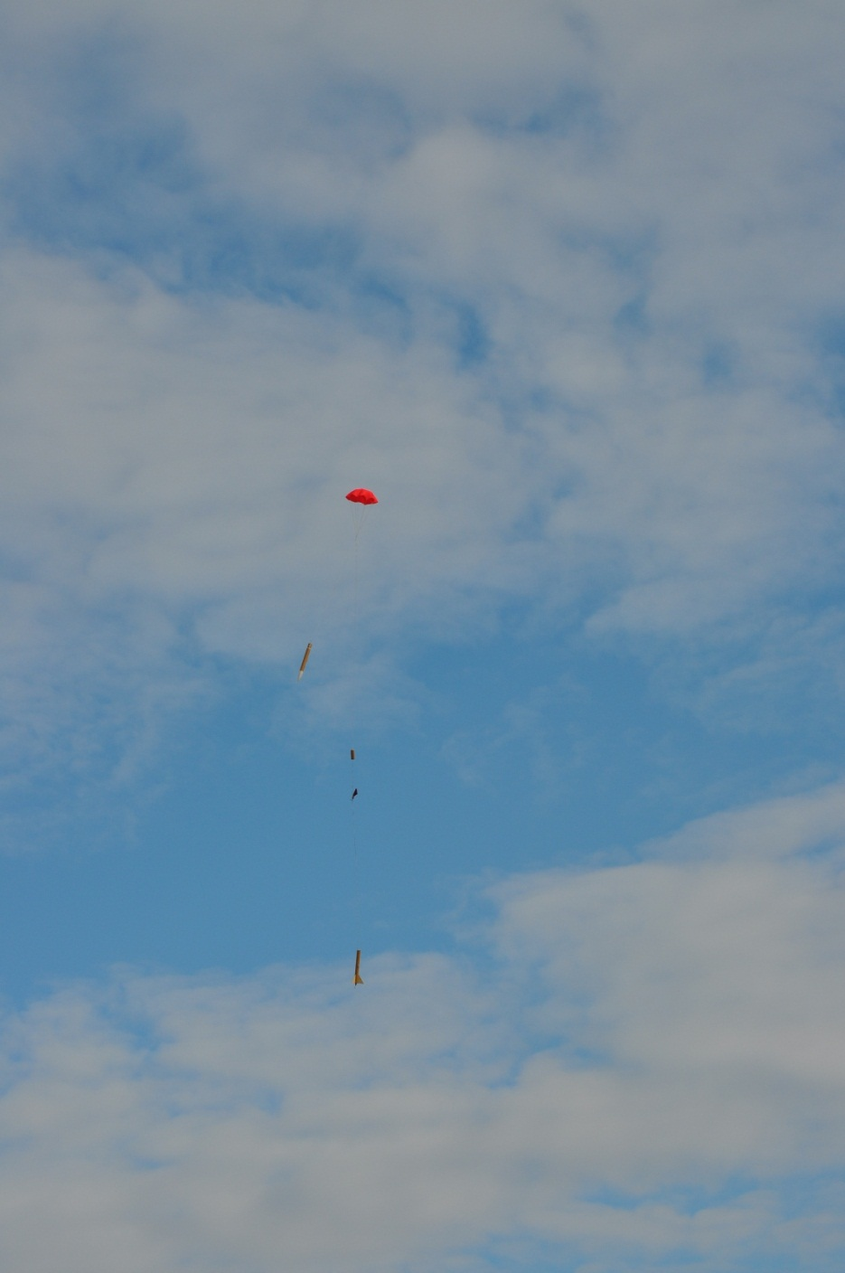
Predicted Drift
Drift at 5 mph, 10 mph, 15 mph, and 20 mph

Slide 11
Test Plans and Procedures
Rocket launches
Payload testing
Safety procedures

Slide 12
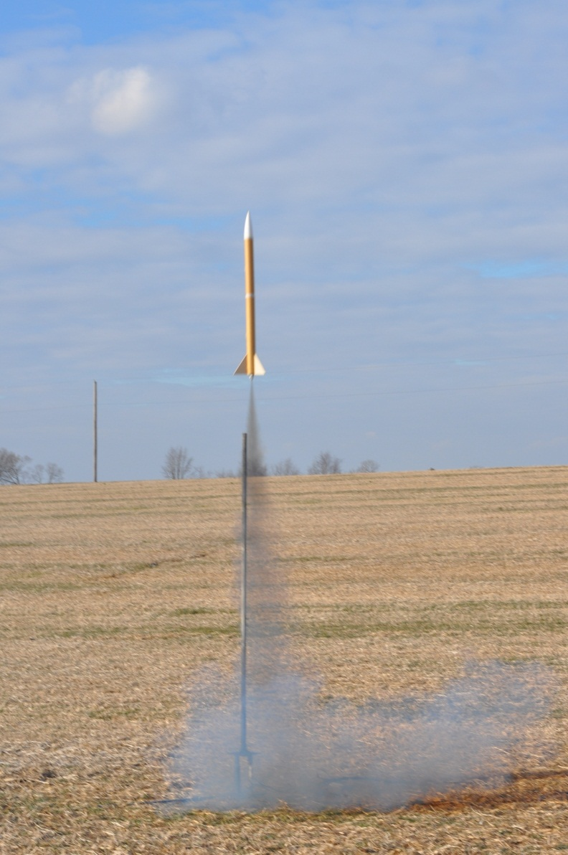
Scale Model Flight Test
January 6th
Results
Recovery
Problems

Slide 13
Tests of Staged Recovery System
Electronics bay
Black powder
Sub-scale launch results

Slide 14
Final Payload Design Overview
New electrical system
Arduino
Part replacements

Slide 15
Payload Integration
Back of rocket
Surrounding components
Attachment to rocket
Parachute

Slide 16
Interfaces
Within launch vehicle
Outside of launch vehicle
Within payload
Outside of payload

Slide 17
Status of Requirements Verification
Currently waiting for particular materials from manufacturers
Starting to build full scale rocket
Educational engagement presentations scheduled

